Slide 1

PACE
UNIVERSITY
2025
PACE UNIVERSITY
Ceremony Central
Team Member :
Aniket
Pavankumar
Jegan
Manihas
Page
01

Slide 2
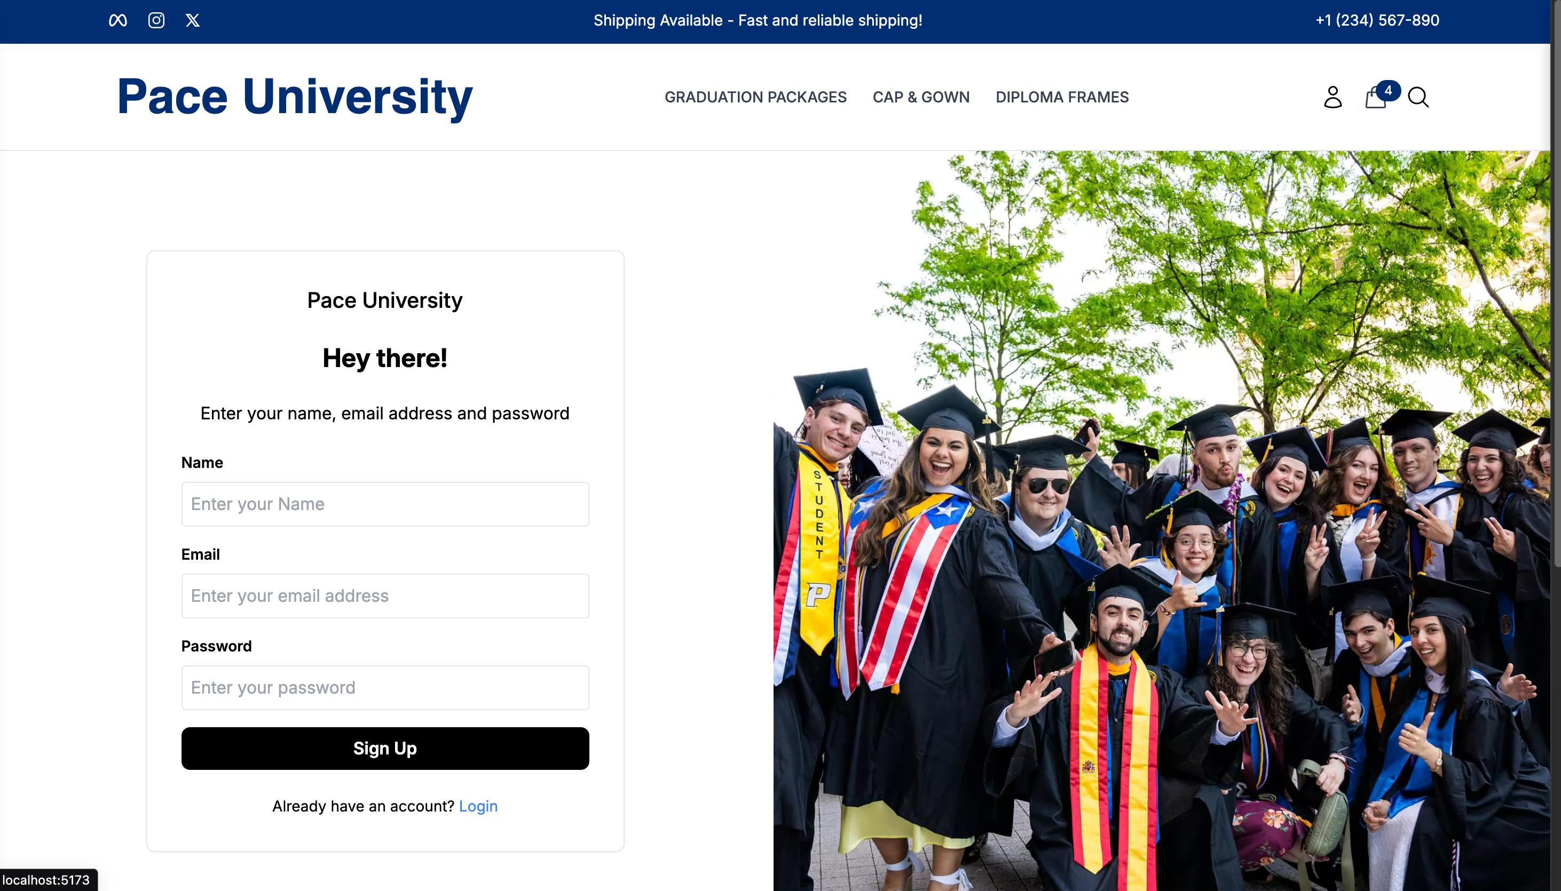
PACE
UNIVERISTY
2025
Introduction
PACE University Merchandise website if focused on making it easy for students to purchase caps and gowns for graduation ceremony, and also other merchandise that are available. This project benefits the students, alumni, faculty and others who are not part of PACE.
Page
02

Slide 3

PACE
UNIVERISTY
2025
Problem
Statement
Currently, Pace University relies on a third-party website to sell caps, gowns, and merchandise, leading to higher costs, limited customization, and reduced control over sales. This creates challenges in branding, inventory management, and customer experience.
To solve this, we developed an official university-backed e-commerce platform that ensures a seamless, secure, and efficient shopping experience. With PayPal integration, students can make safe transactions, while the university gains full control over inventory, pricing, and branding.
Page
03

Slide 4


PACE UNIVERSITY
2025
Objectives
Easy Browising & Ordering
Provide a user-friendly interface that allows students to easily browse, select, and purchase caps, gowns, and merchandise with minimal steps, ensuring a seamless shopping experience.
Secure Online Payment (PayPal)
Ensure a safe and reliable payment process by integrating PayPal, allowing students to make secure transactions with multiple payment options.
Page
04

Slide 5
PACE
UNIVERSITY
2025
Technology
Stack
Frontend
Backend
Database
HTML
CSS
React
NodeJS
MongoDB
Page
05

Slide 6


PACE
UNIVERSITY
2025
System
Architecture
The website follows a three-tier architecture: Frontend, Backend, and Database. Built with MERN stack (MongoDB, Express.js, React, Node.js) for a scalable and dynamic experience. Secure PayPal payment gateway integration for smooth transactions.
Scalability & Future enhancement includes the integration of AI-powered recommendations and chatbots for customer support.
Page
06

Slide 7
PACE UNIVERSITY
2025
Overview
The Website follows a three-tier
architecture: Frontend, Backend, and Database
Built with MERN stack (MongoDB, Express.js, React, Node.js) for a scalable and dynamic experience.
Secure PayPal gateway integration for smooth transaction
Page
04

Slide 8

PACE UNIVERSITY
2025
Components
Frontent (Client-Side) - Developed using React.js for an interactive and responsive UI
Backend (Server-side) - Powered by Node.js & Express.js to handle business logic and API calls.
Database - Utilizes MongoDB for efficient order and inventory management
Athenticity & Secruity - Will be Implementing JWT authentication for secure user access.
Page
04

Slide 9

PACE UNIVERSITY
2025
Workflow
User Interaction - Browses products, add items to cart, and proceeds to checkout
Backend Processing - Manages products availabilty, order details, and payment transactions.
Payment Gateway - PayPal securely processes payments and confirms transactions.
Page
04

Slide 10


PACE UNIVERSITY
2025
Vision and Goals
Create a seamless and intuitive shopping experience for students and faculty.
Maintain Pace University’s branding to foster trust and recognition.
UI / UX
Design
Growth Strategies
Continuous User Feedback – Gather insights to improve usability and functionality.
AI-Powered Personalization – Implement recommendation engines based on user behavior.
Page
07

Slide 11

PACE UNIVERSITY
2025
Challenges &
Solutions
Challenges faced
Dependence on Third-Party Platforms – Limited control over pricing, branding, and order management.
Complex Ordering Process – Students faced difficulties navigating external platforms.
Solutions Implemented
Dedicated University Website – Developed a custom e-commerce platform for direct sales.
User-Friendly Interface – Simplified navigation for easy browsing and ordering.
Page
08

Slide 12



PACE
UNIVERSITY
2024
Future
Enhancements
Personalized Recommendations – Use AI to suggest relevant merchandise based on user preferences and past purchases.
Live Chat Support – Provide instant assistance through AI chatbots or live representatives.
Enhanced Analytics & Reports – Implement dashboards for the university to track sales, trends, and inventory efficiently.
Page
09

Slide 13



PACE
UNIVERSITY
2025
Conclusion
Our project provides Pace University with a dedicated e-commerce platform, replacing third-party sites for selling caps, gowns, and merchandise. It ensures easy browsing, secure PayPal payments, and efficient order management.
By offering a university-branded experience, it enhances accessibility and trust while giving the university full control over sales. This solution streamlines purchases, improves user experience, and enables future growth.
Page
10

Slide 14
PACE
UNIVERSITY
2025
Thank
You.
Feeling Great To Deliver Our Project Infront of You All
Page
11

